Slide 1
CptS 327
Cryptocurrency and Blockchain
Notes:
Template-WSU Hrz 201.ppt

Slide 2
Today’s Topics
Overview
  Cryptocurrencies
  Blockchain
Notes:
Template-WSU Hrz 201.ppt

Slide 3
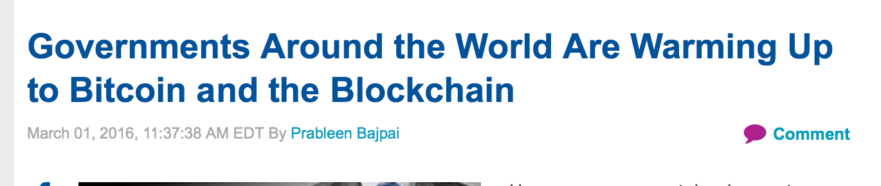
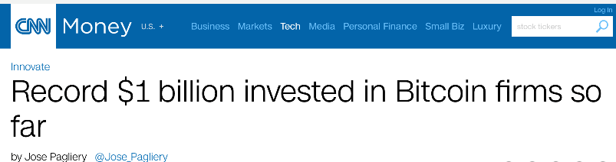
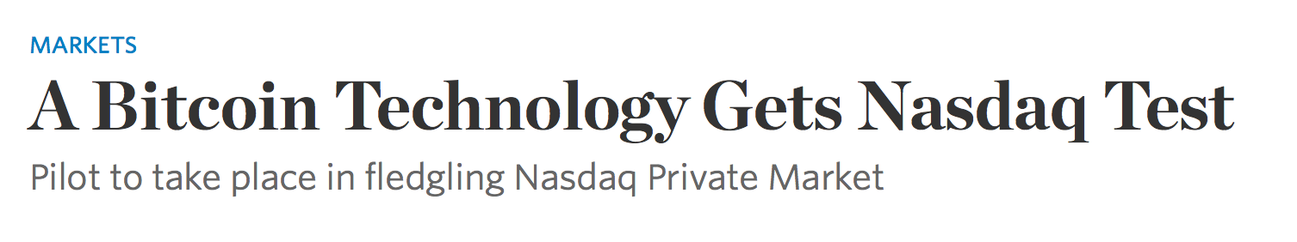
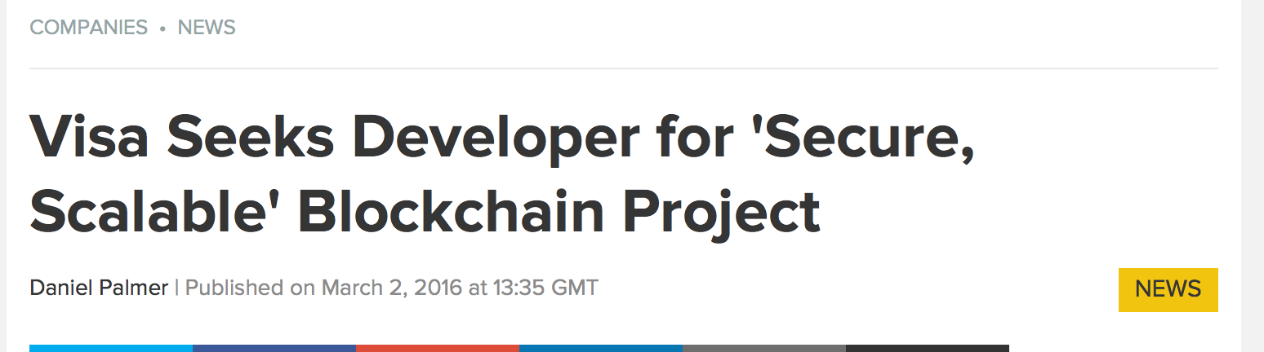
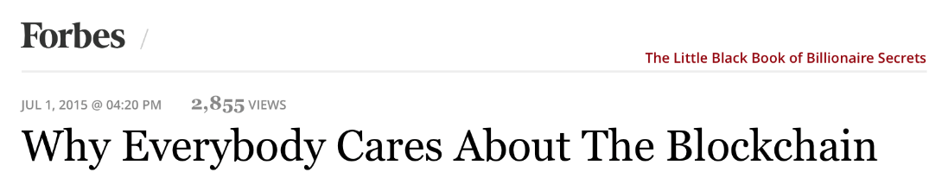
Cryptocurrencies
Notes:
Template-WSU Hrz 201.ppt

Slide 4
Older Cryptocurrencies
Currencies derived from cryptographic ledgers like blockchains
Numerous currencies
  DigiCash, Lucre, MagicMoney
    Double spending problem
      Decentralized: Copy definition files multiple times and become rich
      Centralized: Partialism, favoritism (grant a lot to a few)
    Solution: P2P ledgers
      Implementation of P2P ledgers differ by currency
Notes:
Template-WSU Hrz 201.ppt

Slide 5
Modern Cryptocurrencies
Decentralized i.e., no central authority
Hard to regulate i.e., no / minimal oversight
Popular for
  Anti-fiat hedge
  Money laundering
  Market manipulation
  Financial terrorism
  Darknet transactions
    Illegal activities
Notes:
Template-WSU Hrz 201.ppt

Slide 6
Bitcoin Blockchain
Blockchain: distributed ledger of blocks
Each peer involved in the chain is called a ‘node’
  Each node stores a copy of blockchain
Blocks
  Set of transactions over a predefined period / space
  Computed by using Merkle Trees
  Includes every transaction ever made
    One block of Bitcoin was 415.46 GB as of 7/8/2022
Notes:
Template-WSU Hrz 201.ppt

Slide 7
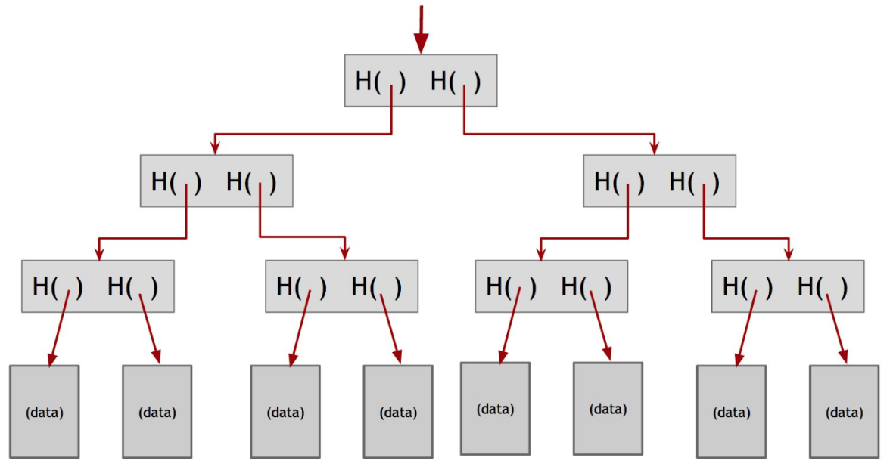
Merkle Trees
A tree of hashes
All transactions in a block hashed into a single digest
Modular
  Can compute sections of tree as transactions are populated
Verifications of transactions can be done by checking the hashes
Notes:
Template-WSU Hrz 201.ppt

Slide 8
Bitcoin Blockchain
Bitcoin enables distributed consensus
  Byzantine fault tolerant
Blockchain integrity is continuously verified by ‘miners’
Transactions
  Each is broadcasted to all peers
  Signed by owner’s private key
  Needs to be verified by all peers before becoming a part of blockchain
Notes:
Template-WSU Hrz 201.ppt

Slide 9
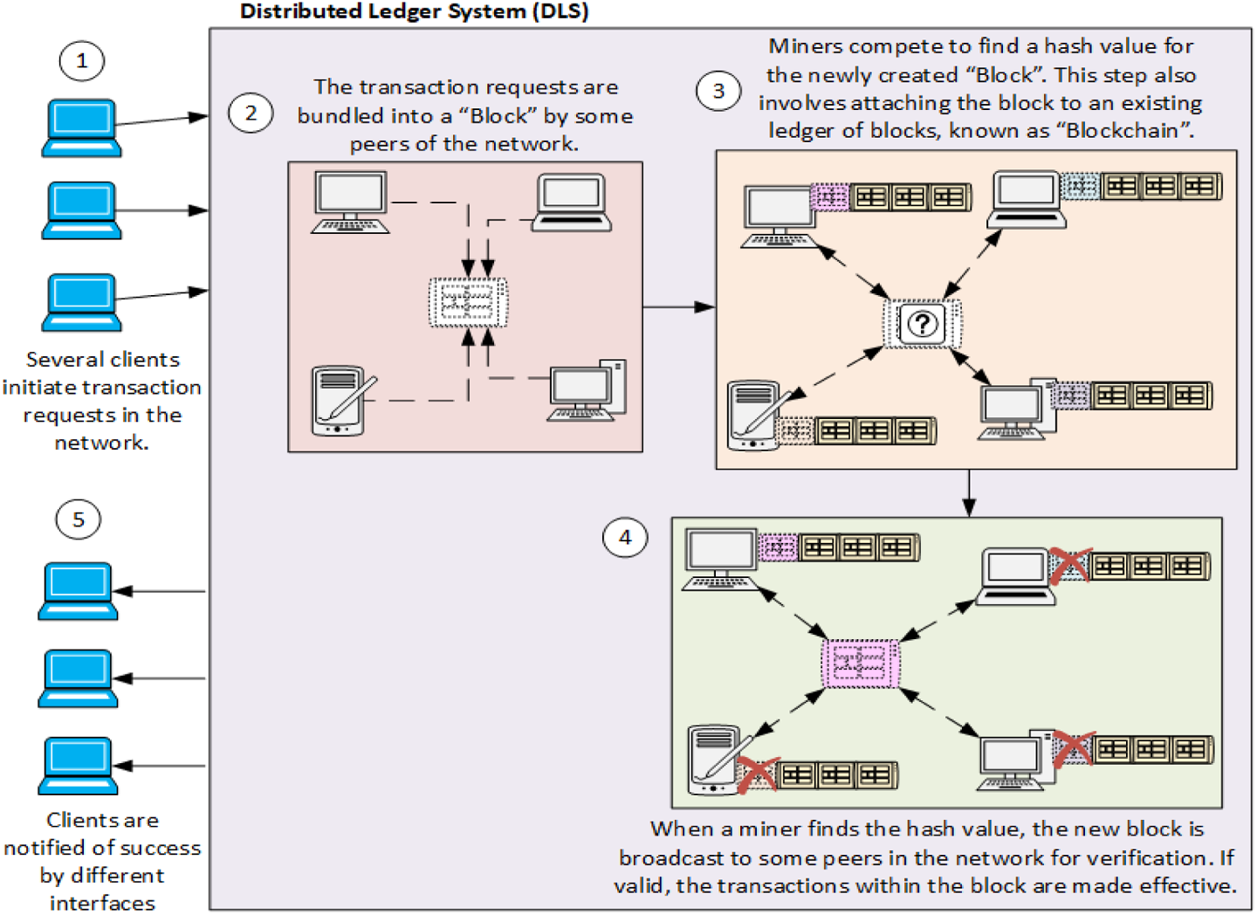
Distributed Consensus
Notes:
Template-WSU Hrz 201.ppt

Slide 10
Bitcoins
A Bitcoin (BTC) is a random number
  Created by ‘miners’ after completing Nakamoto Consensus
  1BTC = ~$67k at its peak
Ownership tracking
  Ledgers map coins to an address
    Address is owner’s public key
  Transacting requires owner to sign with private key
  Lost private key? Lost all your coins
Signing
  SHA-2 (256 bit) hashes
  Elliptic Curve Digital Signature Algorithm (ECDSA)
Notes:
Template-WSU Hrz 201.ppt

Slide 11
ECDSA
e = H(m); H is SHA-2
choose a random number ‘n’
z = L_{n}(e); leftmost bits of e for ‘n’
choose a random number k; 1 <= k <= n-1
choose a random elliptic base point G
  G² = c³ + ac + b; (a, b, c) are random values
elliptic curve point (x₁ , y₁) = k * G
r = x₁ mod n; if r = 0 go to step 3
s = k⁻¹ (z + r * d_{a}) mod n; if s = 0 go to step 3
  d_{a} is the public key of the owner
(r, s) is the signature pair i.e. the owner’s private key
Notes:
Template-WSU Hrz 201.ppt

Slide 12
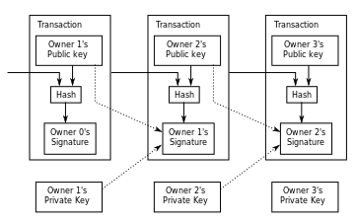
Bitcoin Transactions
Notes:
Template-WSU Hrz 201.ppt

Slide 13
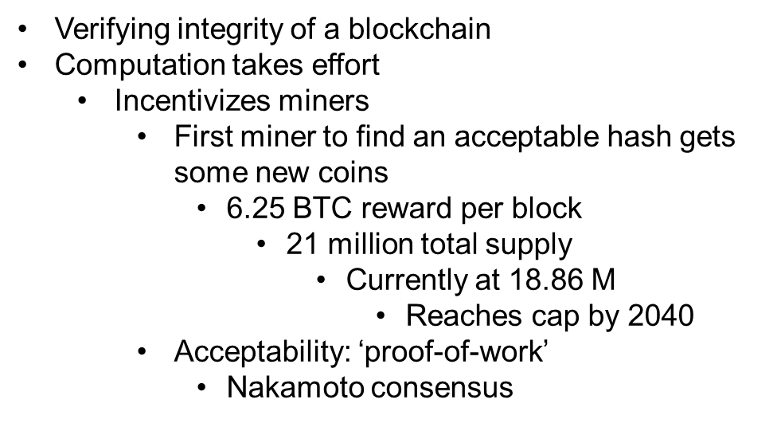
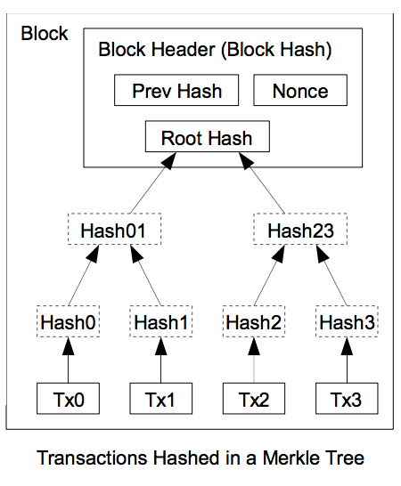
Mining
Notes:
Template-WSU Hrz 201.ppt

Slide 14
Mining
Proof of work
  Makes tampering hard
  Non-deterministic
    Fastest miner doesn’t always win
  One CPU = one vote, majority to accept
  H(nonce || prev_hash || tx … || tx); nonce = target
    Miners pick random nonce
      If yes, win coins → target change
      If no, try again with a diff nonce
        203 million TH/s as of 7/7/2022
Mining pools
  Probability of a sole miner winning = 0
  Miners join in pools
    Pools win a prize, everybody split depending upon compute effort
Notes:
Template-WSU Hrz 201.ppt

Slide 15
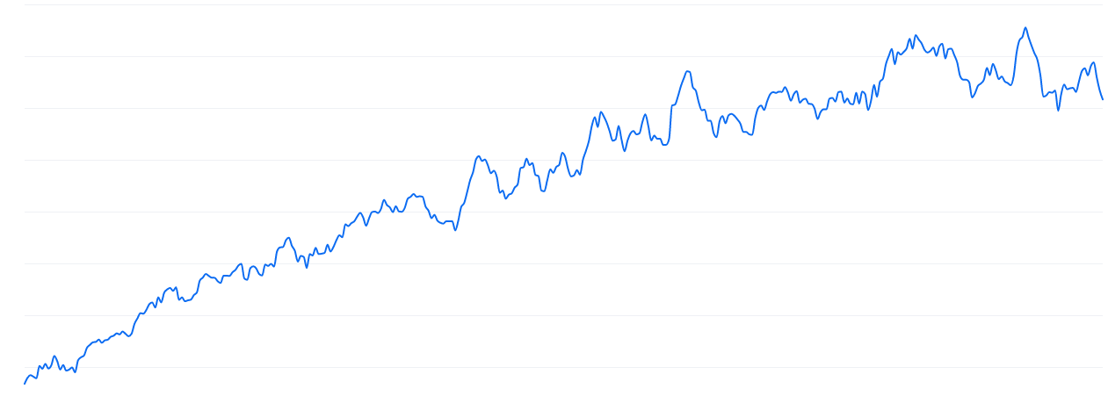
Growing Difficulty to Mine
Notes:
Template-WSU Hrz 201.ppt

Slide 16
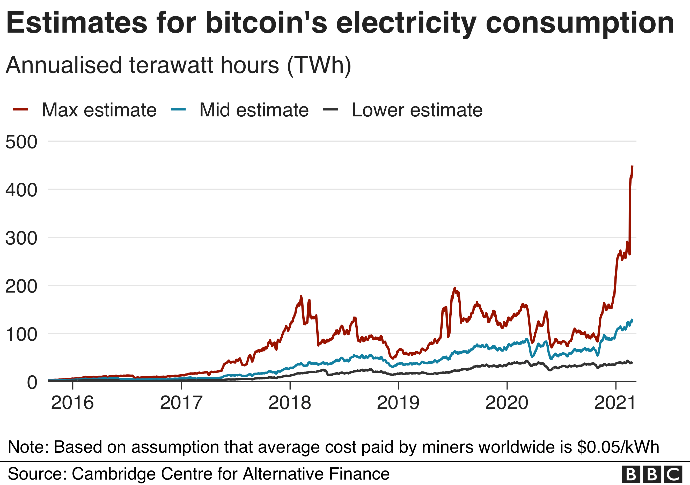
Energy Consumption
https://news.climate.columbia.edu/2022/05/04/cryptocurrency-energy/#:~:text=How%20much%20energy%3F,of%20Argentina%2C%20population%2045%20million
Notes:
Template-WSU Hrz 201.ppt

Slide 17
Ethereum
Bitcoin can execute basic scripts but is primarily a ledger
Ethereum is designed such that peers execute smart contracts
Smart contracts
  Turing complete programs, run on Ethereum Virtual Machine (EVM)
    Functions, transactions, events etc
    One item can call another item e.g. transactions can call functions
  EVMs stored at an address on blockchain
Every operation needs compute power to execute and storage to store
  Ether currency aka ‘Gas’
Ether limits
  Prevents halting problem
    Prevents miners from indefinitely earning Ether
All peers execute smart contracts: slower performance
Notes:
Template-WSU Hrz 201.ppt

Slide 18
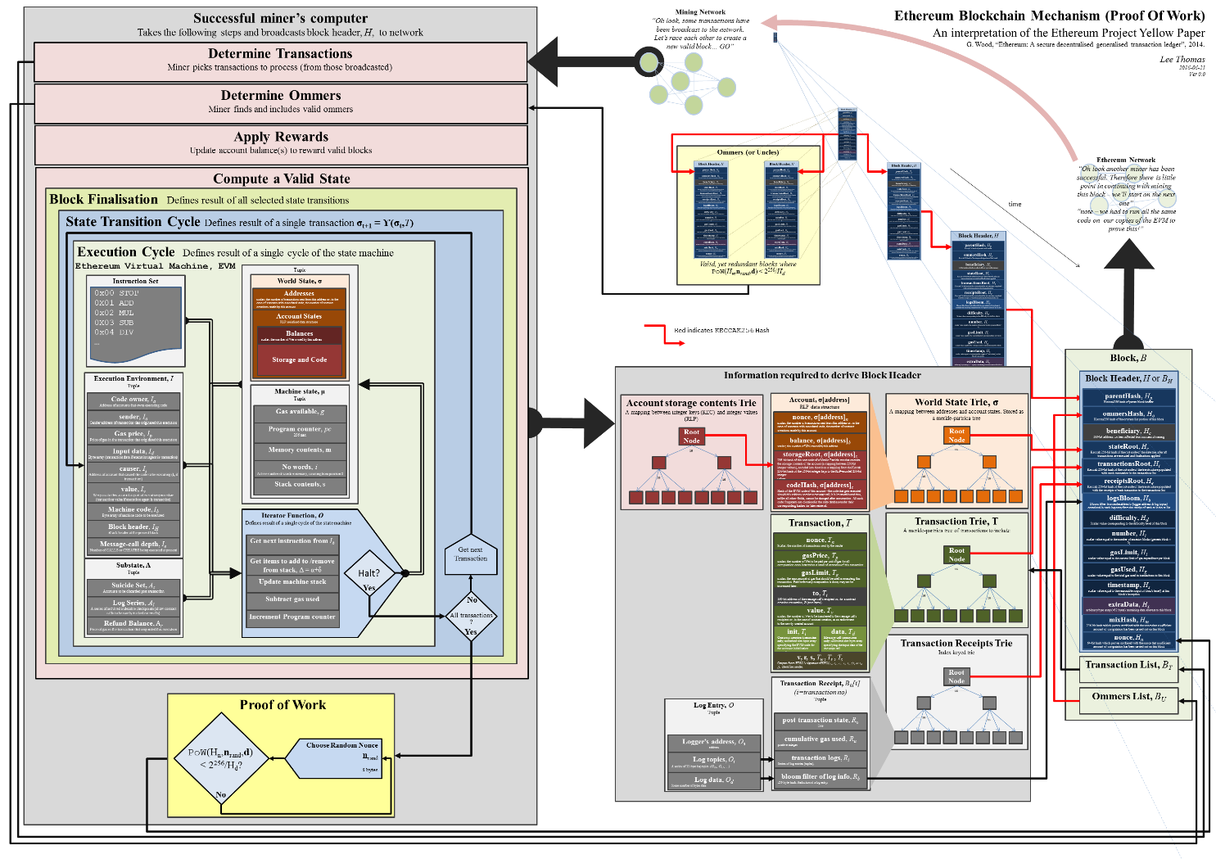
Ethereum
Notes:
Template-WSU Hrz 201.ppt

Slide 19
Vulnerabilities of Cryptocurrency
51% attacks: miners coordinate in pools and if malicious agents dominate the pool, they can tamper the blockchain for gain
  Addressed by pool monitors which alert when a pool is getting close to 51%
    Miners are alerted to leave the pool and rejoin a new pool
    If pool doesn’t decrease in size, it’s kicked out
Denial of Service: takedown miners and prevent transactions
  Inject malicious code into miner pool networks to waste time
  Use SW vulnerabilities to crash miner pools
    Addressed by enforcing strict rules about joining the pool
    Enforce policies regarding code executions in the pool
    Hard to setup and enforce: most pools are insecure
Notes:
Template-WSU Hrz 201.ppt

Slide 20
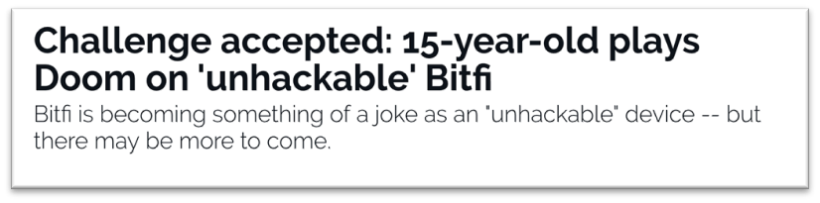
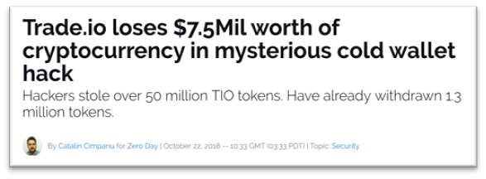
Vulnerabilities of Cryptocurrency
Stealing private keys
  Private keys are usually stored in a software wallet
  Stolen private keys = stolen bitcoins
    Addressed by using hardware wallets or banks to store private keys
      Not completely foolproof
Notes:
Template-WSU Hrz 201.ppt

Slide 21
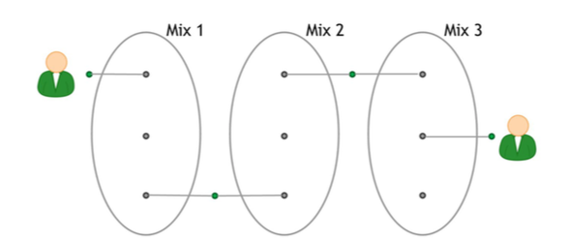
Vulnerabilities of Cryptocurrency
Privacy issues
  All transactions are public
    Transactions are tied to a blockchain address, not a person
    But patterns of activity between addresses can be misused
      Addressed by using an intermediary to increase anonymity
        E.g. ZeroCash / ZeroCoin
https://en.bitcoin.it/wiki/Privacy
Notes:
Template-WSU Hrz 201.ppt

Slide 22

Vulnerabilities of Cryptocurrency
Smart contracts bugs
  Can result in giving currency to unauthorized accounts
  E.g. DAO lost $50 million due a smart contract bug
    Fixed by reverting to a previous ‘hard-fork’ and concurrent ‘soft-fork’
      ETH vs ETC
Notes:
Template-WSU Hrz 201.ppt

Slide 23
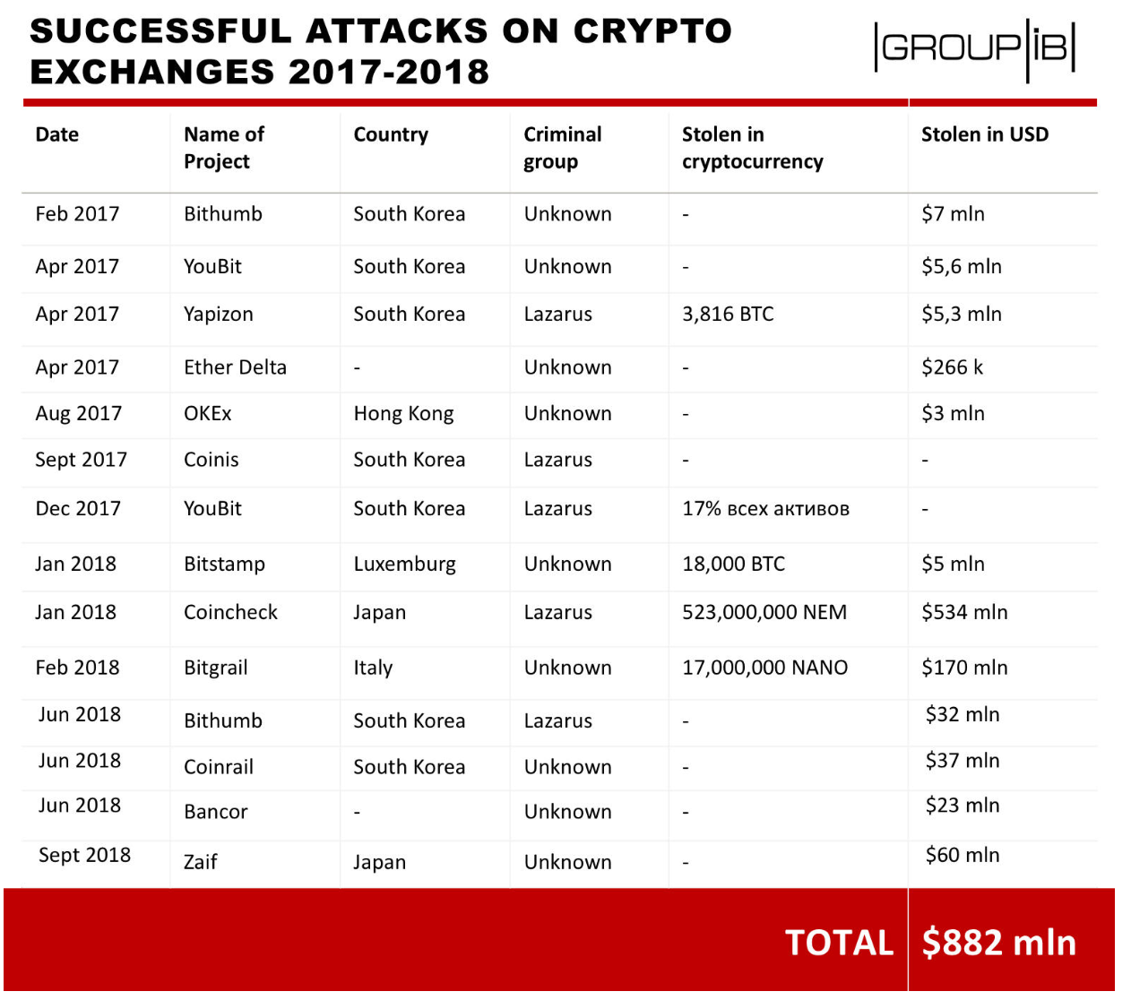
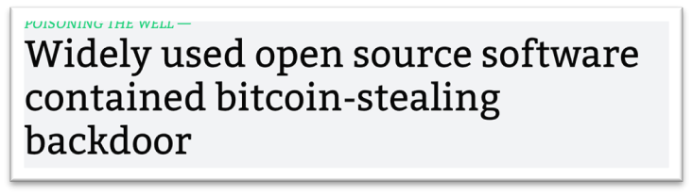
Vulnerabilities of Cryptocurrency
Direct monetary incentive to exploit crypto
Notes:
Template-WSU Hrz 201.ppt

Slide 24
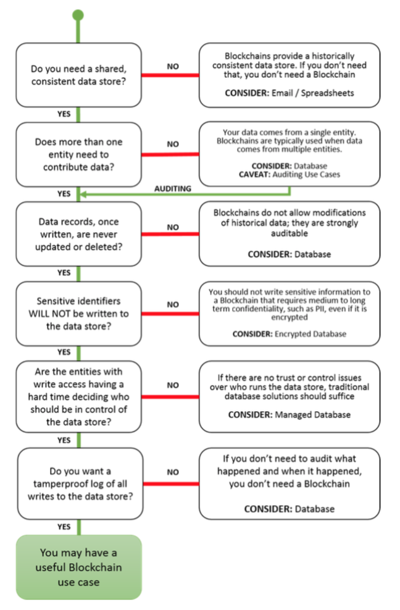
When to use Blockchain Tech?
NISTIR 8202 Blockchain Technology Recommendations
Notes:
Template-WSU Hrz 201.ppt

Slide 25
Future of Crypto?
Bitcoin’s network energy usage is more than Argentina as of May 2022
  Energy efficient consensus mechanism is need
    Maybe by de-incentivizing participants in wrong compute pools
      If win, gain coins
      Otherwise, lose coins
Distributed trust = harder to sell
  Many organizations’ core service is trust
    Banks, markets, clearing houses, CAs, govt.
Practical applications
  Titles for cars, houses, other real property
  Notaries
  Public Auctions
Notes:
Template-WSU Hrz 201.ppt

Slide 26
Resources
Bitcoin: A Peer-to-Peer Electronic Cash System. Satoshi Nakamoto. October 31, 2008
Bitcoin and Cryptocurrency Technologies. Arvind Narayanan, Joseph Bonneau, Edward Felten, Andrew Miller, Steven Goldfeder. Feb 9, 2016
I. Miers, C. Garman, M. Green and A. D. Rubin, "Zerocoin: Anonymous Distributed E-Cash from Bitcoin," Security and Privacy (SP), 2013 IEEE Symposium on, Berkeley, CA, 2013, pp. 397-411.
doi: 10.1109/SP.2013.34
Meiklejohn, Sarah, Marjori Pomarole, Grant Jordan, Kirill Levchenko, Damon McCoy, Geoffrey M. Voelker, and Stefan Savage. “A fistful of bitcoins: characterizing payments among men with no names​. In Proceedings of the 2013 conference on Internet measurement conference, 2013.
Loi Luu, Jason Teutsch, Raghav Kulkarni, and Prateek Saxena. 2015. Demystifying Incentives in the Consensus Computer. In Proceedings of the 22nd ACM SIGSAC Conference on Computer and Communications Security (CCS '15). ACM, New York, NY, USA, 706-719.
Ahmed Kosba, Andrew Miller, Elaine Shi, Zikai Wen, Charalampos Papamanthou. Hawk: The Blockchain Model of Cryptography and Privacy-Preserving Smart Contracts. 20 Jul 2015. https://eprint.iacr.org/2015/675/20150721:040253
Notes:
Template-WSU Hrz 201.ppt

Slide 27
Next lecture
SIEM
Notes:
Template-WSU Hrz 201.ppt

Slide 28
Any questions?
Notes:
Template-WSU Hrz 201.ppt

